Slide 1
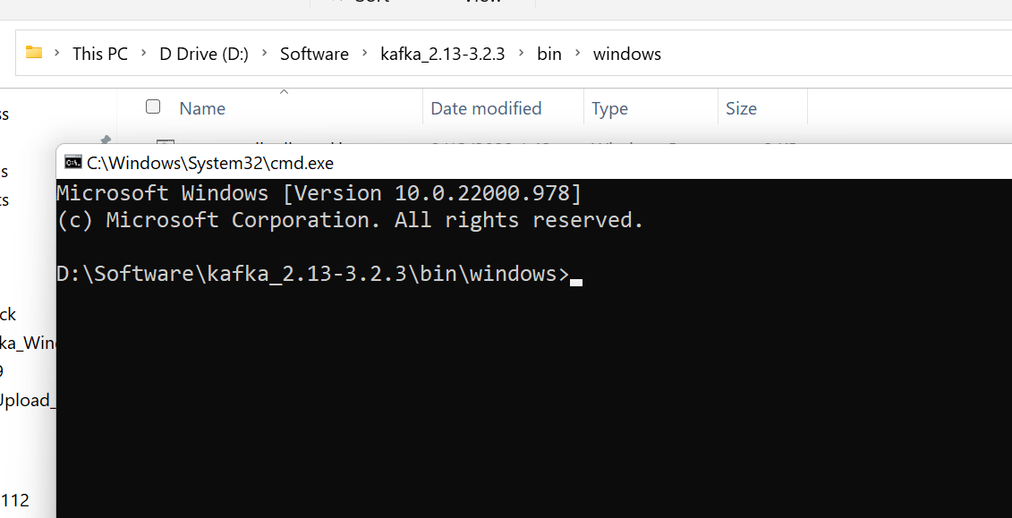
Windows 10/11 - How to Open Command Prompt in Current Folder or Directory?

